Slide 1
Installing Python

Slide 2
Step 1 Download and install python:
https://www.python.org/downloads/
If you already have Python installed, ensure it is version >=3.6

Slide 3
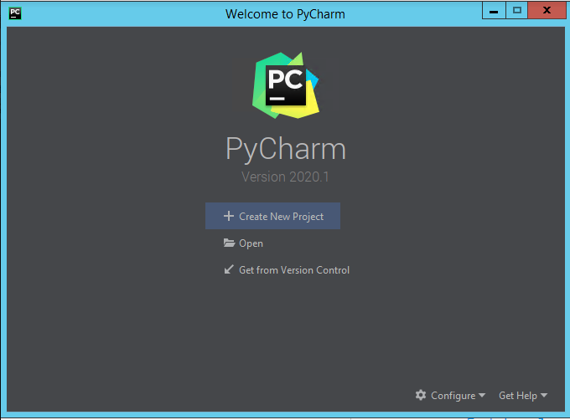
Step 2: Install an IDE
If you have a python ide installed, you can skip to step 4
I recommend PyCharm: https://www.jetbrains.com/pycharm/
The community edition is fine. No need to customize the installation.
Move through the tutorials until you get to the welcome page and select ‘Create New Project’

Slide 4
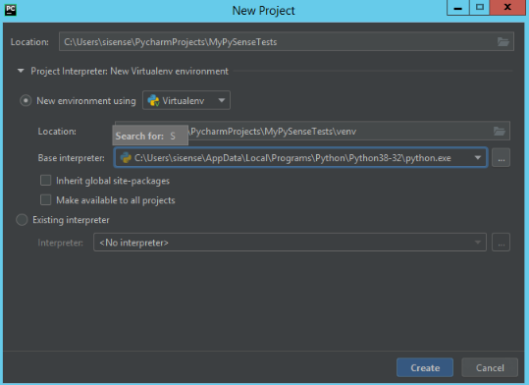
Step 3: Create a new project
After clicking through or skipping the tutorial you will see this screen
Click create a new project.
Change the location folder from untitled to anything you want. Or leave it as untitled. Very meta.
Ensure that PyCharm has found your python and included it in the base interpreter. If that field is blank, click the ... button next to it and manually select your python installation. It should point to the python.exe file wherever you installed it.

Slide 5
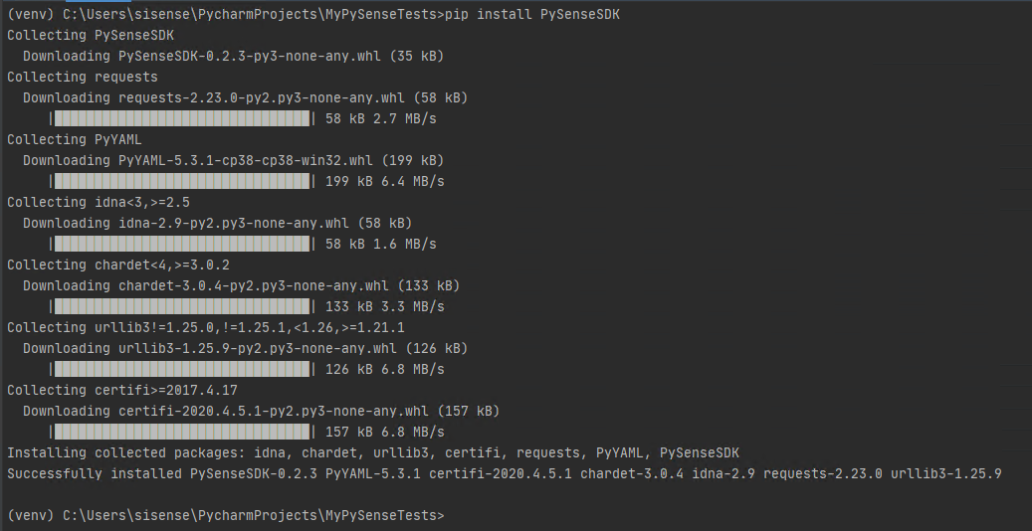
Step 4: Install PySense
Open your terminal and execute ‘pip install PySenseSDK’
If you used PyCharm you can click the terminal button at the bottom of your screen

Slide 6
Step 5: Test PySense
Create a new python file in your ide
In PyCharm: File -> New -> Python file
Create the script below (substitute your authentication details including the port in the host)
Run the script. If success is printed, you are set up with PySense
from PySense import PySense py_client = PySense.PySense('host', 'username', 'password', 'version') # os is either 'Windows' or 'Linux' print('Success')

